Slide 1
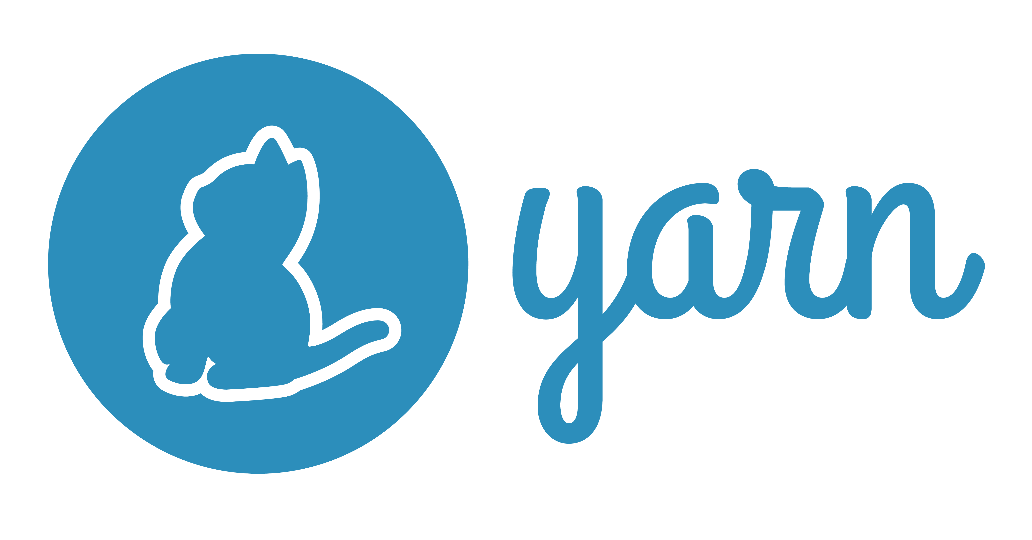


Yarn
Rainer Stropek
software architects gmbh
Web
Mail
Twitter
http://www.timecockpit.com
rainer@timecockpit.com
@rstropek
NPM 5 and Yarn

Slide 2

Your Host
Rainer Stropek
Developer, Entrepreneur
MVP for Azure, MVP for Dev Technologies, MS Regional Director, Trainer at IT-Visions
Contact
software architects gmbh rainer@timecockpit.com Twitter: @rstropek

Slide 3
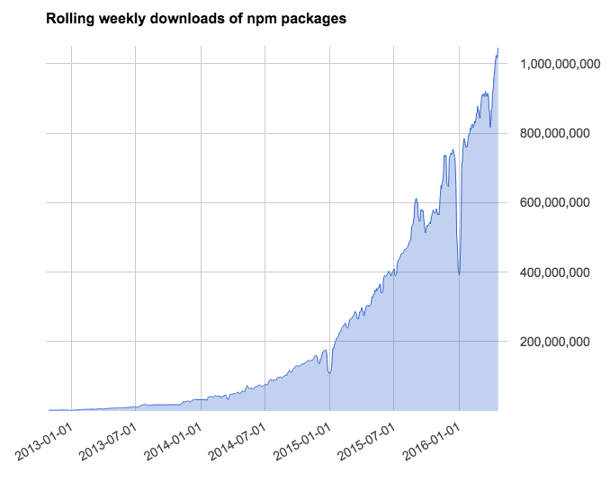
What‘s the Problem?
Package management is critical for non-trivial projects
Example: react dependencies
npm is huge
Exponential growth
> 3 billion downloads/week
npm issues
Installs not fast/consistent enough
Security concerns (NPM allows packages to
run code on installation)
You get different versions on different devices

Slide 4
Yarn came to make everything better…
@5
…and npm@5 catched up

Slide 5
Yarn
An Introduction…

Slide 6
What is Yarn?
Alternative NPM client
package.json -> switch between yarn and npm is easy
Developed by
Facebook, Google, Tilde, Exponent
BSD License
Release in October 2016
Links
Official Website, Github
They have funny icons and Shitty Watercolour artwork ;-)

Slide 7

How to install?
Windows
First you need to install Node.js
Click on this link and install yarn
If you have got Node.js and npm installed
Just write this in the command line
Other operating systems

Slide 8
Install Yarn
npm install -g npm/yarn
which/where yarn
yarn/npm --version

Slide 9
Main Features
Registry compatibility
Same package.json file, means that you can use another package manager
Deterministic install algorithm
The same dependencies will be installed in the same exact way on any machine
Similar to what NPM 5 does
Caching mode
Yarn saves all packages in the global cache

Slide 10
Main Features
Improved network performance and resilience
Parallelizes package downloads
Continuously retrying failed requests
Secure install
Package integrity is checked after each install to avoid corrupt packages
Offline mode
Install used dependencies without internet (global cache)

Slide 11
Commands

Slide 12
Popular Commands
yarn init
Initializes the development of a package
yarn add [package]
Adds a package to use in your current project
yarn (install)
Installs all the dependencies to a package manager
yarn remove
Removes an unused package from your current file
yarn publish [folder]
Publishes a package to a package manager
yarn publish [tarball]
yarn help

Slide 13
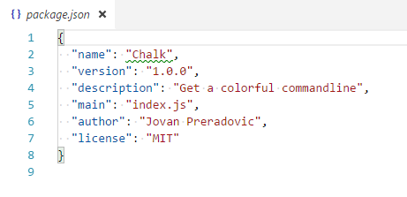
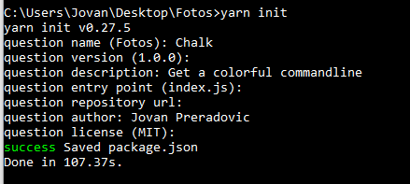
Popular Commands

Slide 14
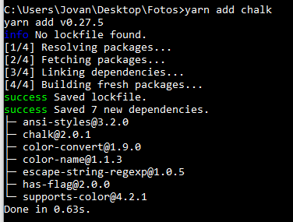
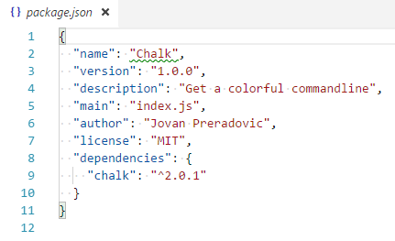
Popular Commands

Slide 15
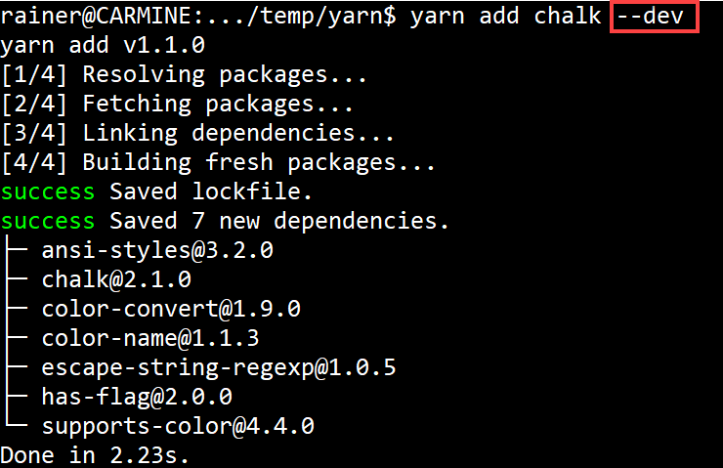
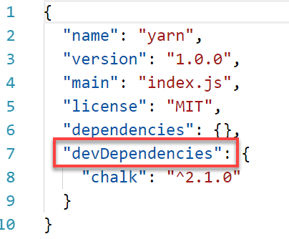
Popular Commands

Slide 16
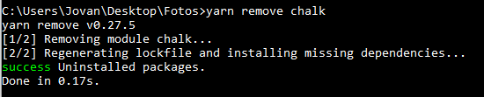
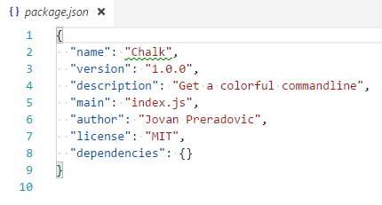
Popular Commands

Slide 17
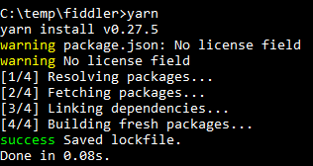
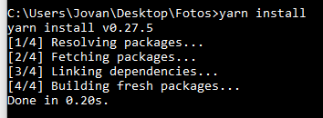
Popular Commands
Two different ways to install packages
or

Slide 18
New Commands
yarn licenses ls
Allows you to inspect the licenses of your dependencies
yarn licenses generate-disclaimer
Automatically create your dependency disclaimer
yarn why [package]
Identify why a package is installed
yarn upgrade-interactive
Allows you to selectivity upgrade specific packages

Slide 19
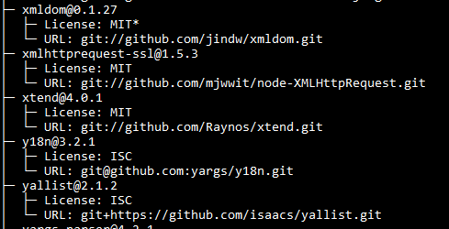
New Commands
yarn licenses ls

Slide 20
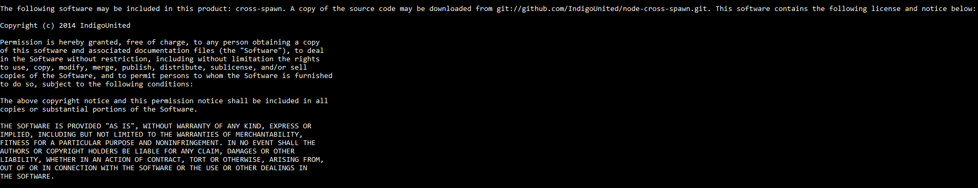
New Commands
yarn licenses generate-disclaimer

Slide 21
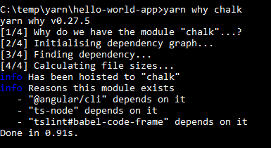
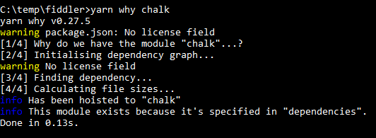
New Commands
yarn why [package]

Slide 22
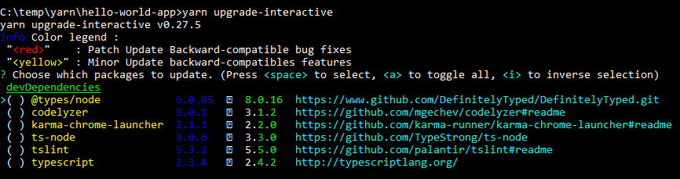
New Commands
yarn upgrade-interactive

Slide 23
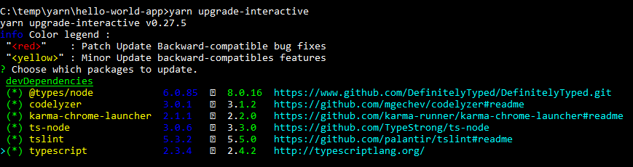
New Commands
yarn upgrade-interactive

Slide 24
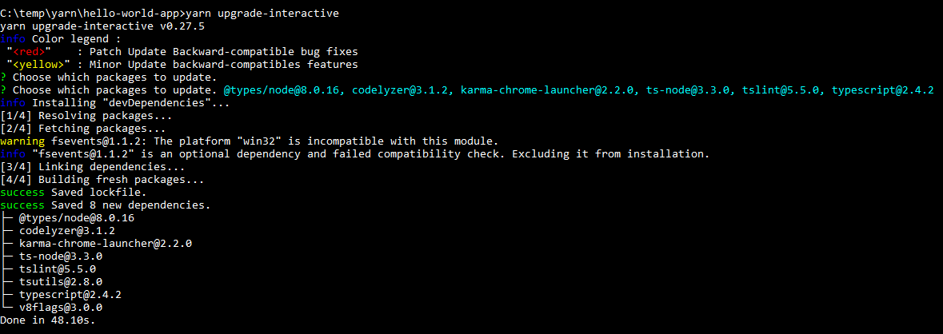
New Commands
yarn upgrade-interactive

Slide 25
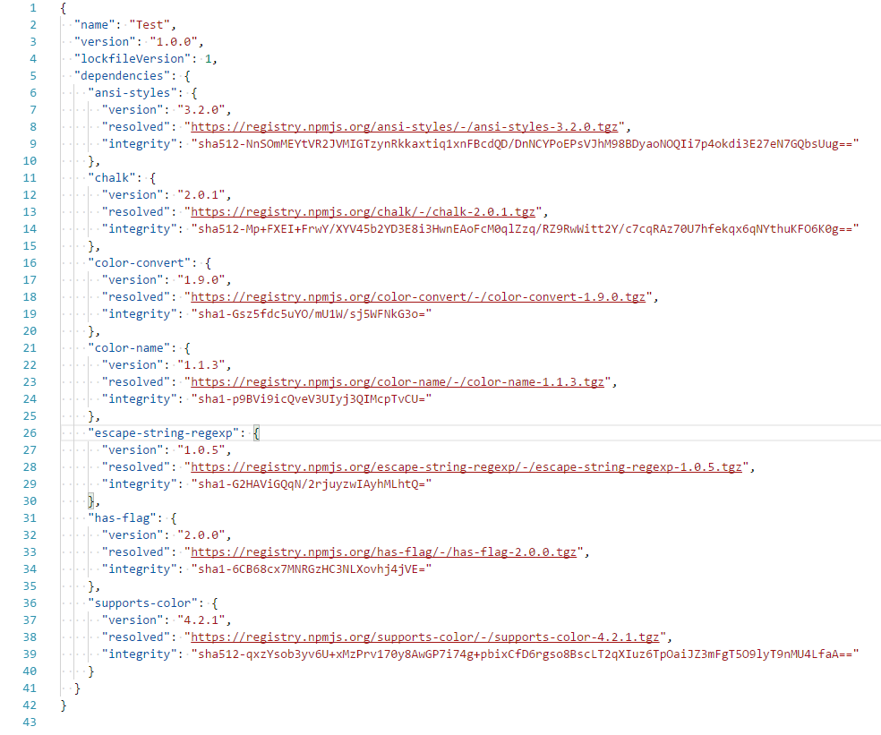
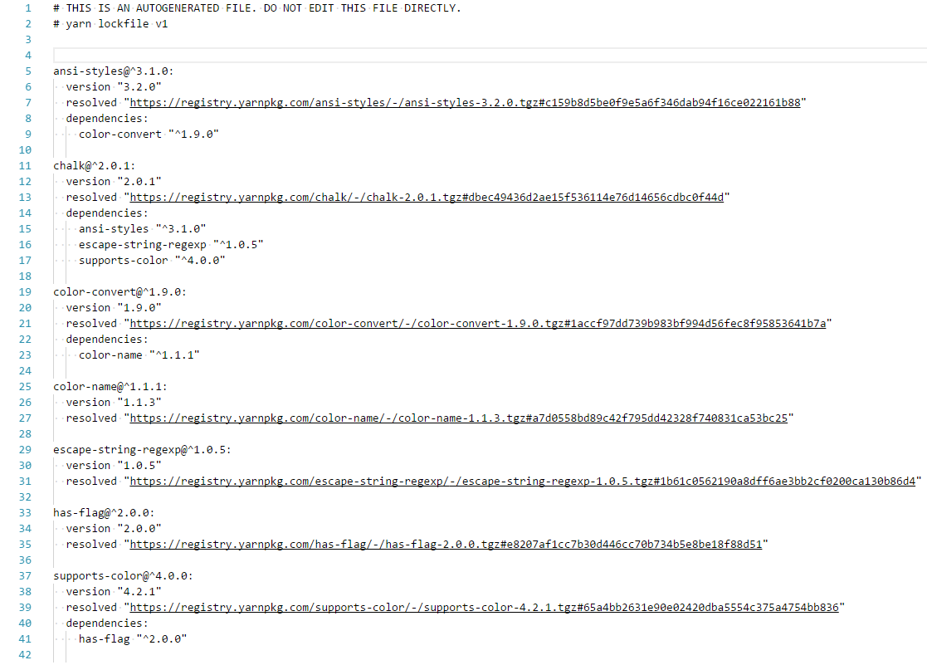
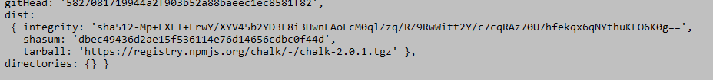
Lockfile Comparison
yarn.lock
package-lock.json

Slide 26
Lockfile Comparison
https://github.com/yarnpkg/yarn/issues/816
yarn.lock

Slide 27
Install Process
Resolution
Resolve dependencies by making requests to the registry and recursively looking up each dependency
Fetching
Save package tarballs on the global cache (offline mode, speed up)
Linking
Copy all files from global cache to node_modules directory

Slide 28



Resolution
or
Chalk package hierarchy
chalk
ansi-styles
color-convert
escape-string-regexp
supports-color
has-flag
color-name

Slide 29
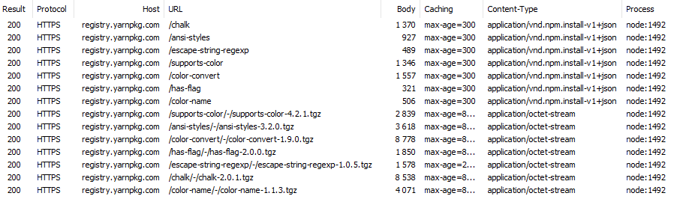
Resolution
On this picture you see how the package chalk gets downloaded from yarn

Slide 30
Resolution
Console
yarn config set "strict-ssl" false –g
yarn add [package]
Fiddler
Wait for response!
Important to set again TRUE

Slide 31
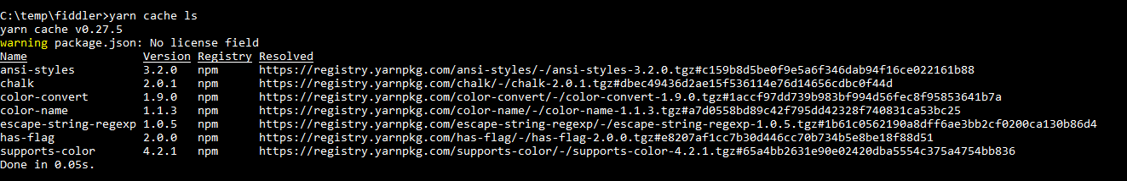
Fetching
yarn cache list
Shows the global cache (tarball files)

Slide 32

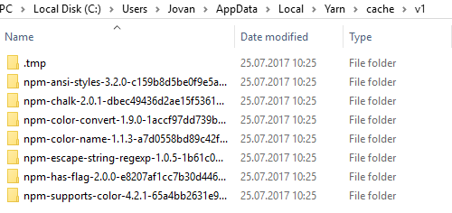
Fetching
yarn cache dir
Shows the path of the global cache

Slide 33
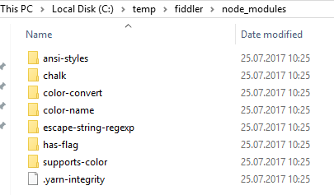
Linking
All files from chalk package
were copied into the
node_modules directory

Slide 34
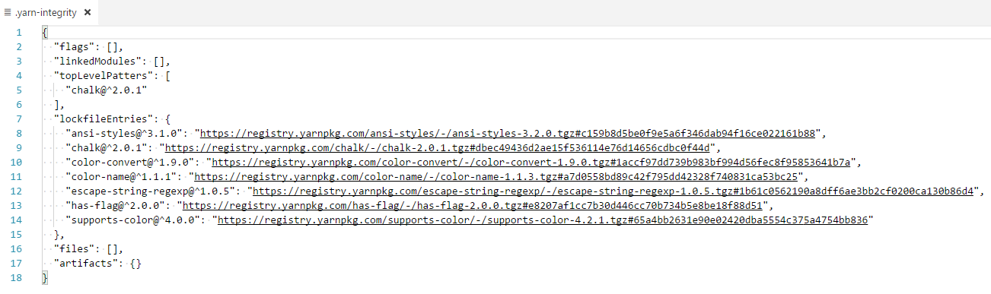
.yarn-integrity File
Generated from the yarn.lock file, to check the versions of the dependencies

Slide 35
Install Angular CLI
Console commands
yarn global add @angular/cli
ng set --global packageManager=yarn
ng new hello-world-app
cd hello-world-app
ng serve

Slide 36
NPM 5
What‘s New?

Slide 37
NPM 5
Blog post
Got a speed update (from 20% to 100% faster)
Shrinkwrap does not exist anymore
Lockfiles and cache works almost like yarn (SHA512 hashes)
Do not need --save anymore
Package output tree is gone

Slide 38
Summary

Slide 39
Yarn killed npm?
No!
Yarn is just an alternative client
NPM ecosystem is used under the covers
NPM@5 is very similar to Yarn
You could mix inside a team – not sure if you should
Yarn has icons ;-) (on some platforms)
Competition is good for business
Even in the Open Source world

Slide 40
Q&A
NPM 5 and Yarn
Rainer Stropek
software architects gmbh
Web
Mail
Twitter
http://www.timecockpit.com
rainer@timecockpit.com
@rstropek
Thank your for coming!

